Slide 1
B.Tech Integrated Synopsis Presentation
A.Y. 2021-2022 Project Title: Disease Detection System using Machine Learning
Presented by: Vaibhav Raheja (C056)
Viraj Shah (C064)
Mayank Shetty (C075)
Purav Patel (C098)
Under The Guidance of: Prof. Manisha Tiwari

Slide 2
Roadmap
Introduction to the domain area/project
Problem Statement
Motivation and Purpose of the project
Project Scope and Objectives
Plan of action to complete the project
References

Slide 3
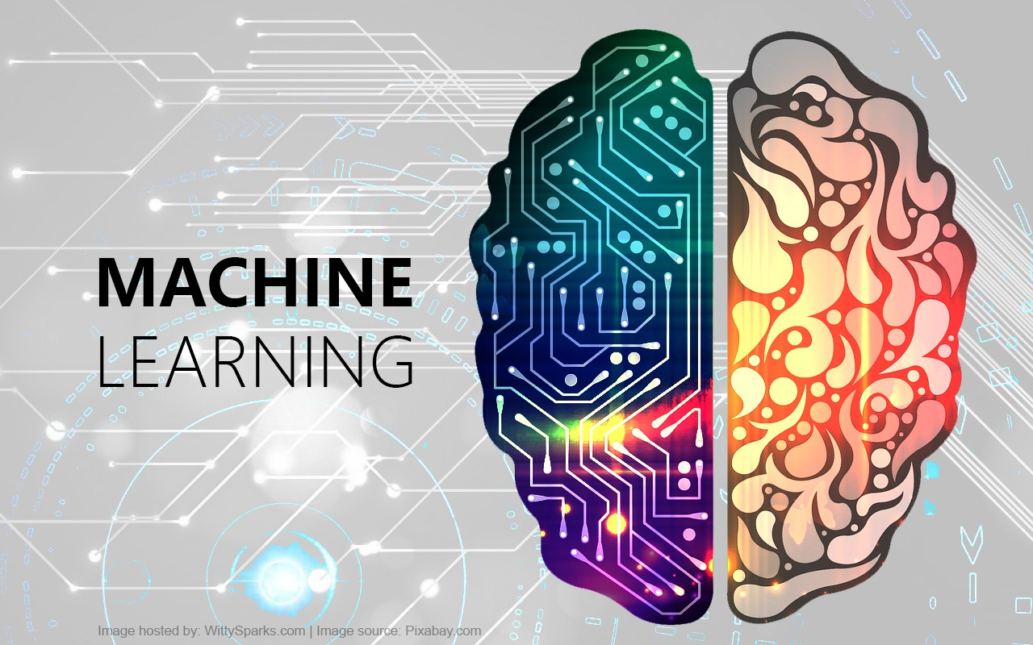
Introduction to Machine Learning
Machine learning (ML) is the study of computer algorithms that improve automatically through experience and by the use of data.
It is seen as a part of Artificial Intelligence (AI).
Machine learning algorithms build a model based on sample data, to make decisions without any explicit programming.

Slide 4
Problem Statement
During the COVID-19 Pandemic, several hospitals faced a severe shortage of highly-skilled doctors.
The ones who were available at times required an expert system, to help them aid in diagnosing a patient’s condition.
However, these expert systems may be much more useful, if they could personalise the diagnosis for each and every patient, with the help of an available doctor.

Slide 5
Motivation
There has been an immense load on hospitals and doctors during the COVID-19 Pandemic, and helping the world to our best ability in these tough times is our goal.
Our aim is to reduce the pressure on doctors and hospitals by creating an expert machine that detects several major diseases.

Slide 6
Scope of the project
Our model will have a Disease Detection System that will be based on Machine Learning.
Our output will show if the patient has that particular disease and will give relative Information related to the disease
The Diseases that we are planning on targeting are:
Pneumonia
COVID - 19
Chronic Kidney Disease
Heart Attack

Slide 7
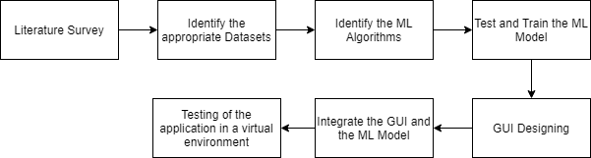
Plan of Action

Slide 8
References
[1] G. Çınarer and B. G. Emiroğlu, "Classificatin of Brain Tumors by Machine Learning Algorithms," 2019 3rd International Symposium on Multidisciplinary Studies and Innovative Technologies (ISMSIT), 2019, pp. 1-4, doi: 10.1109/ISMSIT.2019.8932878.
[2] G. Hemanth, M. Janardhan and L. Sujihelen, "Design and Implementing Brain Tumor Detection Using Machine Learning Approach," 2019 3rd International Conference on Trends in Electronics and Informatics (ICOEI), 2019, pp. 1289-1294, doi: 10.1109/ICOEI.2019.8862553.
[3] M. S. Fasihi and W. B. Mikhael, "MRI brain tumor classification Employing transform Domain projections," 2020 IEEE 63rd International Midwest Symposium on Circuits and Systems (MWSCAS), 2020, pp. 1020-1023, doi: 10.1109/MWSCAS48704.2020.9184678.
[4] M. Kavitha, G. Gnaneswar, R. Dinesh, Y. R. Sai and R. S. Suraj, "Heart Disease Prediction using Hybrid machine Learning Model," 2021 6th International Conference on Inventive Computation Technologies (ICICT), 2021, pp. 1329-1333, doi: 10.1109/ICICT50816.2021.9358597.
[5] F. Alotaibi, “Implementation of Machine Learning Model to Predict Heart Failure Disease”, International Journal of Advanced Computer Science and Applications (IJACSA), 10(6), 2019, doi: 10.14569/IJACSA.2019.0100637.
[6] J. Qin, L. Chen, Y. Liu, C. Liu, C. Feng and B. Chen, "A Machine Learning Methodology for Diagnosing Chronic Kidney Disease," in IEEE Access, vol. 8, pp. 20991-21002, 2020, doi: 10.1109/ACCESS.2019.2963053.

Slide 9
References
[7] F. M. Javed Mehedi Shamrat, P. Ghosh, M. H. Sadek, M. A. Kazi and S. Shultana, "Implementation of Machine Learning Algorithms to Detect the Prognosis Rate of Kidney Disease," 2020 IEEE International Conference for Innovation in Technology (INOCON), 2020, pp. 1-7, doi: 10.1109/INOCON50539.2020.9298026.
[8] R. Gupta, N. Koli, N. Mahor and N. Tejashri, "Performance Analysis of Machine Learning Classifier for Predicting Chronic Kidney Disease," 2020 International Conference for Emerging Technology (INCET), 2020, pp. 1-4, doi: 10.1109/INCET49848.2020.9154147.
[9] T. Ozturk, M. Talo, E. Yildirim, U. Baloglu, O. Yildirim, U. Acharya, “Automated detection of COVID-19 cases using deep neural networks with X-ray images.”, Computers in biology and medicine vol. 121 (2020), 2020, doi: 10.1016/j.compbiomed.2020.103792.
[10] A. Sharma, M. Negi, A. Goyal, R. Jain and P. Nagrath, “Detection of Pneumonia using ML & DL in Python.”, IOP Conference Series: Materials Science and Engineering 1022, 2021, doi: 10.1088/1757-899X/1022/1/012066.

